Slide 1
Computer Organization and Architecture (AT70.01)
Comp. Sc. and Inf. Mgmt.
Asian Institute of Technology
Instructor: Dr. Sumanta Guha
Slide Sources: Based on CA: aQA by Hennessy/Patterson. Supplemented from various freely downloadable sources

Slide 2
Advanced Topic:
Dynamic Hardware Branch Prediction
Ca:aQA Sec. 3.4

Slide 3
Static Prediction
Does not take into account the run-time history of the particular branch instruction – whether it was taken or not taken recently, how often it was taken or not taken, etc.
Simplest static prediction:
  predict always taken
  predict always not taken
More complex static prediction:
  performed at compile time by analyzing the program…

Slide 4
Dynamic prediction:
1-bit Predictor
Branch- prediction buffer or branch history table (BHT) is a cache indexed by a fixed lower portion of the address of the branch instruction
1-bit prediction: for each index the BHT contains one prediction bit (also called history bit) that says if the branch was last taken or not – prediction is that branch will do the same again
1
prediction bit
0
a₃₁a₃₀…a₁₁…a₂a₁a₀
branch instruction
1K-entry BHT
10-bit index
1
Instruction memory

Slide 5
Dynamic prediction:
1-bit Predictor
Meaning of prediction bit
  1 = branch was last taken
  0 = branch was last not taken
Using the BHT
  index into the BHT and use the prediction bit to predict branch behavior
    note the prediction bit may have been set by a different branch instruction with the same lower address bits but that does not matter – the history bit is simply a hint
  if prediction is wrong, invert prediction bit
Example: Consider a loop branch that is taken 9 times in a row and then not taken once. What is the prediction accuracy of 1-bit predictor for this branch assuming only this branch ever changes its corresponding prediction bit?
  Answer: 80%. Because there are two mispredictions – one on the first iteration and one on the last iteration. Why?

Slide 6
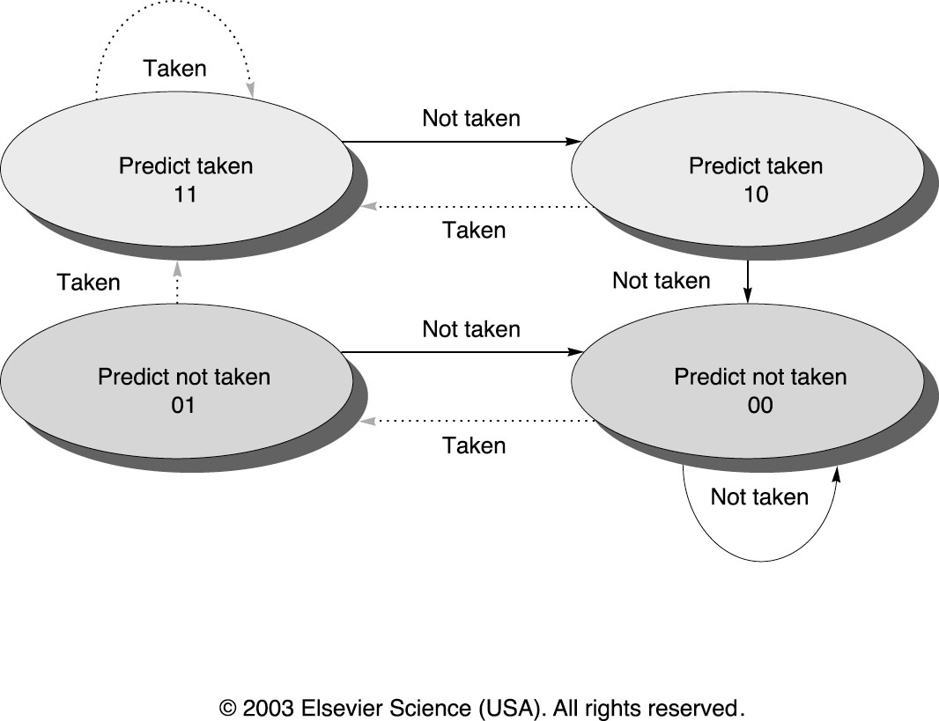
Dynamic prediction:
2-bit Predictor
2-bit prediction: for each index the BHT contains two prediction bits that change as in the figure below
Key idea: the prediction must be wrong twice for it to be changed
Example: What is the prediction accuracy of a 2-bit predictor on the loop of the previous example?

Slide 7
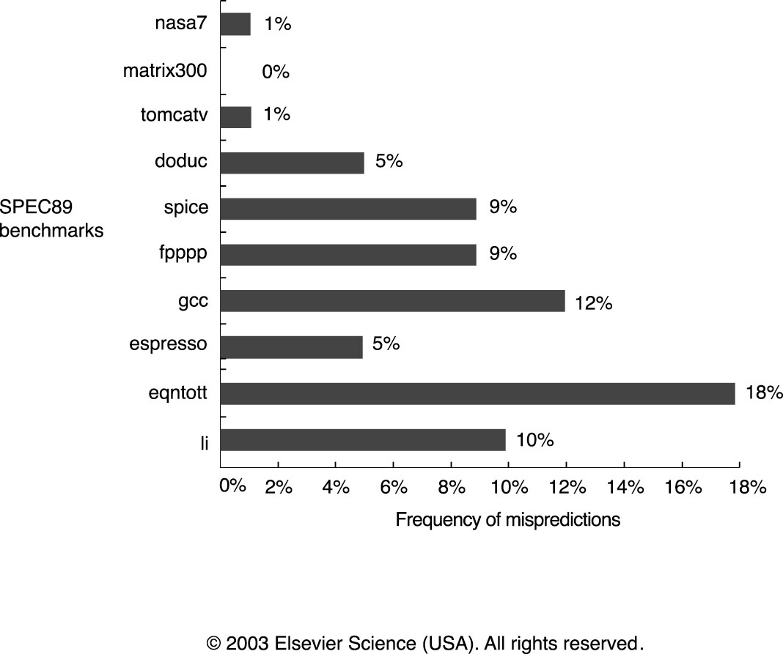
2-bit Predictor Statistics
Prediction accuracy of 4K-entry 2-bit prediction buffer on SPEC89 benchmarks:
accuracy is lower for integer programs (gcc, espresso, eqntott, li) than for FP

Slide 8
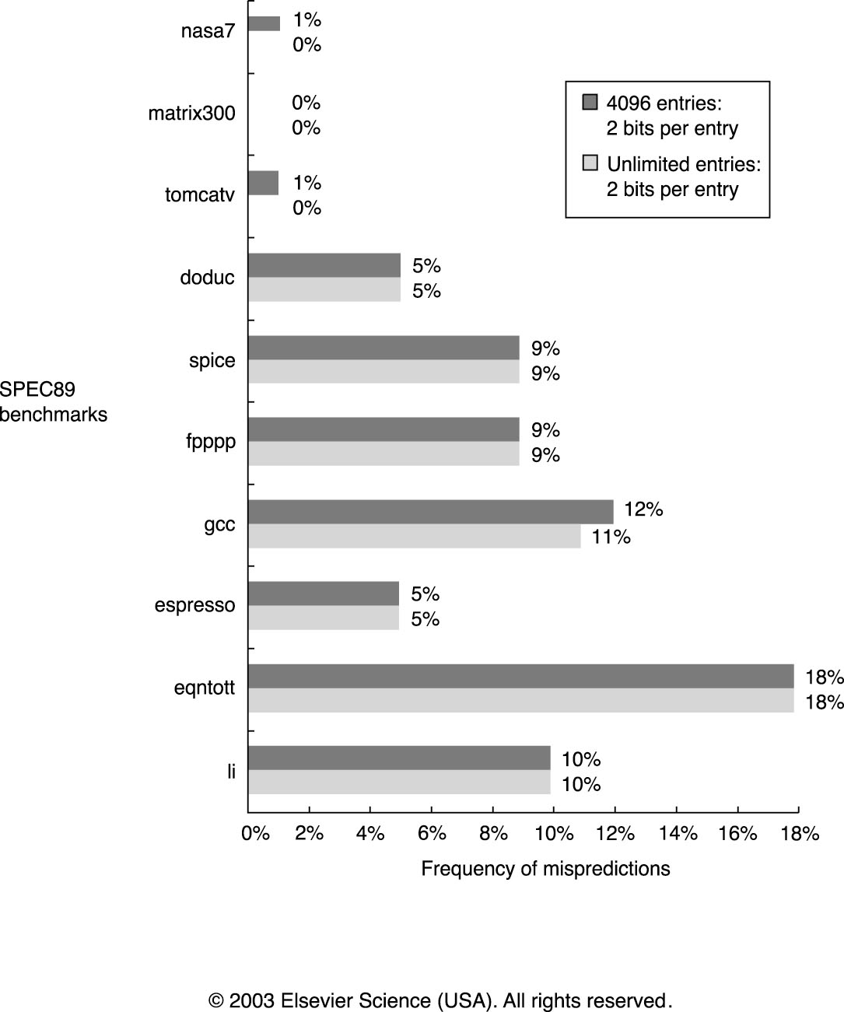
2-bit Predictor Statistics
Prediction accuracy of 4K-entry 2-bit prediction buffer vs. “infinite” 2-bit buffer:
increasing buffer size from 4K does not significantly improve performance

Slide 9
n-bit Predictors
Use an n-bit counter which, therefore, represents a value X where 0 ≤ X ≤ 2^{n} – 1
  increment X if branch is taken (to a max of 2^{n})
  decrement X if branch is not taken (to a min of 0)
  If X ≥ 2^{n-1}, then predict taken; otherwise, untaken
Studies show that there is no significant improvement in performance using n-bit predictors with n > 2, so 2-bit predictors are implemented in most systems

Slide 10
Correlating Predictors
Key idea: branch b3 behavior is correlated with the behavior of branches b1 and b2
  because if branches b1 and b2 are both not taken, then the statements following the branches will set aa=0 and bb=0
  ⇒ b3 will be taken
if (aa == 2)
aa = 0;
if (bb == 2)
bb=0;
if (aa! = bb) {…
DSUBUI R3, R1, #2
BNEZ R3, L1 ; branch b1 (aa != 2)
DADD R1, R0, R0 ; aa = 0
L1: DSUBUI R3, R2, #2
BNEZ R3, L2 ; branch b2 (bb != 2)
DADD R2, R0, R0 ; bb = 0
L2: DSUB R3, R2, R1 ; R3 = aa – bb
BEQZ R3, L3 ; branch b3 (aa == bb)
Code fragment from
eqntott SPEC89 benchmark
Corresponding MIPS code:
aa is in R1, bb is in R2

Slide 11
Correlating Predictors:
Simple Example
if (d == 0)
d = 1;
if (d == 1) {
BNEZ R1, L1 ; branch b1 (d != 0)
DADDIU R1, R0, #1 ; d==0, so d=1
L1: DADDIU R3, R1, #-1
BNEZ R3, L2 ; branch b2 (d != 1)
…
L2
Simple code
fragment
Corresponding MIPS code:
d is in R1
Initial Value Values of d
of d d==0? b1 before b2 d==1? b2
0 yes not taken 1 yes not taken
1 no taken 1 yes not taken
2 no taken 2 no taken
Possible execution sequences assuming d is one of 0, 1, or 2

Slide 12
Correlating Predictors:
Impact of Ignoring Correlation
Initial Value Values of d
of d d==0? b1 before b2 d==1? b2
0 yes not taken 1 yes not taken
1 no taken 1 yes not taken
2 no taken 2 no taken
Possible execution sequences assuming d is one of 0, 1, or 2
d= b1 b1 new b1 b2 b2 new b2
prediction action prediction prediction action prediction
NT T T NT T T
0 T NT NT T NT NT
NT T T NT T T
0 T NT NT T NT NT
Behavior of 1-bit predictor initialized to not taken with d alternating
between 2 and 0: 100% misprediction!

Slide 13
Correlating Predictors:
Taking Correlation into Account
Prediction bits Prediction if last branch not taken Prediction if last branch taken
NT/NT NT NT
NT/T NT T
T/NT T NT
T/T T T
Meaning of 1-bit predictor with 1 bit of correlation: equivalent to assuming two separate
prediction bits – one assuming last branch executed was not taken and one assuming
the last branch executed was taken
d= b1 b1 new b1 b2 b2 new b2
prediction action prediction prediction action prediction
2 NT/NT T T/NT NT/NT T NT/T
0 T/NT NT T/NT NT/T NT NT/T
2 T/NT T T/NT NT/T T NT/T
0 T/NT NT T/NT NT/T NT NT/T
Behavior of 1-bit predictor with 1-bit of correlation, assuming initially NT/NT and d
alternating between 0 and 2: mispredictions only on first iteration. Analyze why…!
Predictions used in red.

Slide 14
Correlating Predictors:
(m,n) Predictors
The correlating predictor as before – 1 bit of prediction plus 1 correlating bit – is called a (1,1) predictor
Generalization of the (1,1) predictor is the (m,n) predictor
(m,n) predictor : use the behavior of the last m branches to choose from one of 2^{m} branch predictors, each of which is an n-bit predictor
The history of the most recent m branches is recorded in an m-bit shift register called the m-bit global history register
  shift in the behavior bit for the most recent branch, shift out the the bit for the least recent branch
Index into the BHT by concatenating the lower bits of the branch instruction address with the m-bit global history to access an n-bit entry

Slide 15
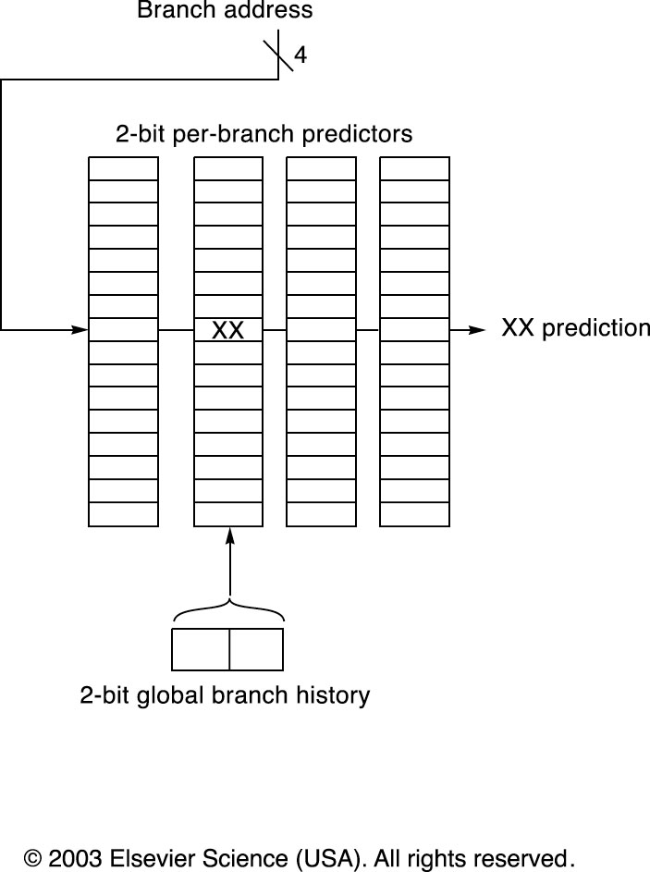
Correlating Predictors:
Data Structures
A (2,2) BHT uses the 2-bit global history to choose from one of four predictors
for each branch address. In the following 16 entry BHT each of the four predictors
has 16 2-bit entries and 4 bits of the branch instruction address is used to choose
one of these entries.
The BHT is shown as four separate arrays; in actuality it is one 2-bit wide linear array.

Slide 16
Simple Examples
Note : A 2-bit predictor with no global history is simply a (0,2) predictor
How many bits are in a (0,2) predictor with 4K entries?
  Total bits = 2⁰ × 2 × 4K = 8K
How many bits are in a (2,2) predictor with 16 entries (shown in previous figure)?
  Total bits = 64 × 2 = 128
How many branch-selected entries are in a (2,2) predictor that has a total of 8K bits in the BHT? How many bits of the branch address are used to access the BHT
  Total bits = 8K = 2² × 2 × no. prediction entries selected by branch
  Therefore, no. prediction entries selected by branch = 1K
  Therefore, no. of bits of branch address used to index BHT = 10

Slide 17
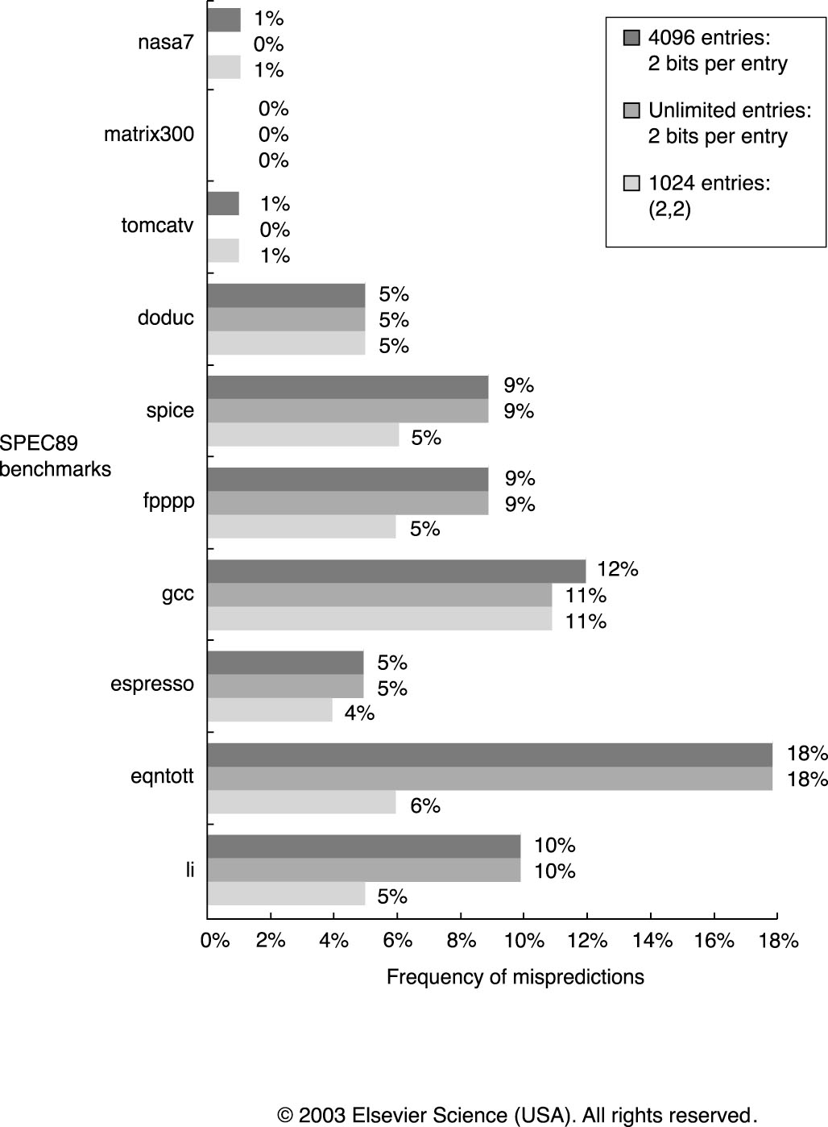
2-bit Predictor Statistics
A (2,2) predictor with 1K entries outperforms not only a 2-bit no-history predictor
with 4K entries but also a 2-bit no-history predictor with unlimited entries

